Slide 1
Attachment III-4: Stakeholder ERM Risk Briefing PowerPoint Template
December 2024 | Version 1.0
#PublicPower www.PublicPower.org
Notes:
Note:
To change the format of the slide deck to fit the utility’s style, go to View, then go to Slide Master.
Change the format and customize according to the utility’s approved format and logo.

Slide 2
Agenda
Utility’s ERM program background
ERM program accomplishments and updates
Summary of utility’s risks
Next steps and future outlook
Notes:
Slide Objective: Provide meeting agenda

Slide 3
Vision & Mission Statement/ERM Policy
[Insert utility’s vision & mission statement or ERM policy here]
Notes:
Note: This is a sample only and should be tailored according to the utility’s needs.
Slide Objective: Provide reference to the utility’s ERM vision/mission statement or the ERM policy
3

Slide 4
ERM Governance Structure
[Insert utility’s ERM governance structure here]
Notes:
Note: This is a sample only and should be tailored according to the utility’s needs.
Slide Objective: Provide reference to the utility’s ERM governance structure
4

Slide 5
ERM Approach and Timeline
Identify and agree on risks and/or opportunities to the achievement of strategic goals and objectives
Occurs quarterly
Business priorities, vision and mission, performance and objectives
Identify
Enterprise Risk Management Process
Assess risks against standard risk rating criteria to support qualitative risk prioritization for impact, likelihood, and management preparedness
Occurs quarterly
Monitor risk mitigation effectiveness using “leading,” not “lagging,” metrics; leverage defined acceptable risk tolerance and/or KRIs to inform risk escalations
Occurs biannually
Monitor
Assess
Communicate
Respond
Provide a holistic risk portfolio report focused on achieving performance objectives and designed to enable management decision-making
Ongoing
Identify risk responses and adjust strategy to achieve or exceed performance objectives balanced to risk appetite
Ongoing
Notes:
Note: This is a sample only and should be tailored according to the utility’s needs.
Slide Objective: Provide overview of the utility’s approach and Timeline for the ERM program
5

Slide 6
Risk Assessment Scale – Likelihood
[Include definition of likelihood and utility’s likelihood scale]
#PublicPower www.PublicPower.org
Notes:
Note: This is a sample only and should be tailored according to the utility’s needs.
Slide Objective: Provide overview of the ERM program’s risk assessment scale
6

Slide 7
Risk Assessment Scale – Impact
[Include definition of likelihood and utility’s impact scale]
#PublicPower www.PublicPower.org
Notes:
Note: This is a sample only and should be tailored according to the utility’s needs.
Slide Objective: Provide overview of the ERM program’s risk assessment scale
7

Slide 8
Utility’s Risk Tolerance Levels and Risk Limits
[Include definition of risk tolerance and risk limit]
[Include relationship of risk tolerance and limits to how the utility’s prioritizes risks]
Notes:
Note: This is a sample only and should be tailored according to the utility’s needs.
Slide Objective: Provide overview of the utility’s risk tolerance and risk limits
8

Slide 9
ERM Program Accomplishments & Activities
[Include recent accomplishments (depending on the ERM program’s reporting schedule) of the ERM program such as conduction of workshops, interviews, update to risk register, identification of new risks, etc.]
[Include staffing/personnel updates, if necessary]
[Encourage stakeholders to stay engaged in risk identification throughout the year]
Notes:
Note: This is a sample only and should be tailored according to the utility’s needs.
Slide Objective: Provide accomplishments and recent activities of the ERM program and the ERM committee
9

Slide 10
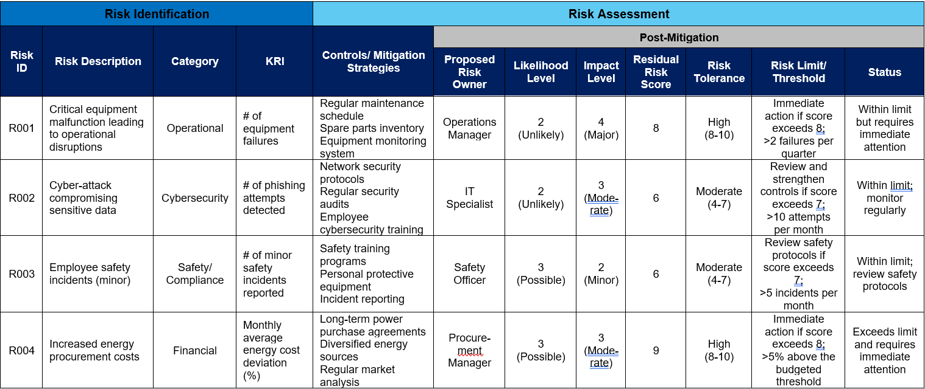
Risk Assessment Summary – Risk Register
Notes:
Note: This is a sample only and should be tailored according to the utility’s needs.
Slide Objective: Provide high-level summary of the risk register – only include the prioritized risks
10

Slide 11
Risk Assessment Results – Heat Map
 | Likelihood
Impact |  | 1 (Very Unlikely) | 2 (Unlikely) | 3 (Possible) | 4 (Likely) | 5 (Almost Certain)
 | 5 (Catastrophic) | R002
 | 4 (Major) |  | R001
 | 3 (Moderate)
 | 2 (Minor) |  |  | R003
 | 1 (Negligible)
Notes:
Note: This is a sample only and should be tailored according to the utility’s needs.
Slide Objective: Provide heat mapping – visualization of the prioritized risks. This is to encourage stakeholders to stay engage in the program and participate in continuously identifying and mitigating risks and creating a risk aware culture in the utility
11

Slide 12
Utility’s Risk Landscape Compared to State’s Risk Profile (Optional)
[Utilities can utilize their respective state’s energy sector risk profile to compare against their identified and prioritized risks]
Utilities can obtain information from the DOE State and Regional Risk Profiles
Notes:
Note: This is a sample only and should be tailored according to the utility’s needs.
Slide Objective: Provide high-level overview of the utility’s risk landscape compared to their State’s Risk Profile

Slide 13
Next Steps for ERM Program
[List short-term goals and long-term goals of the ERM program]
  This could include upcoming risk-related trainings available
  Opportunity to get involved in the risk process
[List ways how stakeholders can continue informing the ERM committee on existing and emerging risks]
[Provide point of contact for the ERM committee/program]
Notes:
Talking Points
As we look to the future, we are not just reactive; we are forward-thinking, planning for the long-term sustainability of our utility.
Our goals and initiatives are designed to anticipate and adapt to future risks, ensuring that [Utility Name] remains a resilient and innovative leader in the industry.

