Slide 1
Attachment III-1: ERM Prioritized Risks & Action Plans Briefing PowerPoint Template
December 2024 | Version 1.0
Notes:
Note:
To change the format of the slide deck to fit the utility’s style, go to View, then go to Slide Master.
Change the format and customize according to the utility’s approved format and logo.

Slide 2
Agenda
Utility’s ERM background
Risk assessment results
Utility’s risk tolerance levels and risk limits
ERM program accomplishments and activities
Review of utility’s prioritized risks
Recommendations
Next steps
Notes:
Slide Objective: Provide meeting agenda

Slide 3
Vision & Mission Statement/ERM Policy
[Insert utility’s vision & mission statement or ERM policy here]
Notes:
Note: This is a sample only and should be tailored according to the utility’s needs.
Slide Objective: Provide overview of the entire read-ahead.
3

Slide 4
ERM Governance Structure
[Insert utility’s ERM governance structure here]
Notes:
Note: This is a sample only and should be tailored according to the utility’s needs.
Slide Objective: Provide overview of the entire read-ahead.
4

Slide 5
ERM Approach
Identify and agree on risks and/or opportunities to the achievement of strategic goals and objectives
Occurs quarterly
Business priorities, vision and mission, performance and objectives
Identify
Enterprise Risk Management Process
Monitor risk mitigation effectiveness using “leading,” not “lagging,” metrics; leverage defined acceptable risk tolerance and/or KRIs to inform risk escalations
Occurs biannually
Assess risks against standard risk rating criteria to support qualitative risk prioritization for impact, likelihood, and management preparedness
Occurs quarterly
Monitor
Assess
Communicate
Respond
Provide a holistic risk portfolio report focused on achieving performance objectives and designed to enable management decision-making
Ongoing
Identify risk responses and adjust strategy to achieve or exceed performance objectives balanced to risk appetite
Ongoing
Notes:
Note: This is a sample only and should be tailored according to the utility’s needs.
Slide Objective: Provide overview of the entire read-ahead.
5

Slide 6
ERM Approach Explained
[Include detailed schedule for the ERM process for the utility here. For example, the ERM committee meets quarterly to identify and assess risks, the ERM committee reports on risk summary biannually to the governing board, etc.]
Notes:
Note: This is a sample only and should be tailored according to the utility’s needs.
Slide Objective: Provide overview of the entire read-ahead.
6

Slide 7
Risk Assessment Scale – Likelihood
[Include definition of likelihood and utility’s likelihood scale]
Notes:
Note: This is a sample only and should be tailored according to the utility’s needs.
Slide Objective: Provide overview of the entire read-ahead.
7

Slide 8
Risk Assessment Scale – Impact
[Include definition of likelihood and utility’s impact scale]
Notes:
Note: This is a sample only and should be tailored according to the utility’s needs.
Slide Objective: Provide overview of the entire read-ahead.
8

Slide 9
Utility’s Risk Tolerance Levels and Risk Limits
Risk Category | Risk Details | Tolerance Level | Residual Risk Score Scale | Risk Limit
Operational Downtime | Minimal operational downtime ensures service reliability and prevents customer dissatisfaction. For public power utilities, keeping downtime below X hours helps maintain consistent service. | Low (X-X hours) | 1-4: Low risk 5-8: Moderate risk 9-10: High risk | Immediate action required if downtime exceeds X hours; investigate causes of downtime immediately, implement corrective actions, and communicate with stakeholders regarding service status
Financial Loss | Limits financial exposure to manageable levels, ensuring the utility can absorb potential losses without significant impact on its operations or financial stability. | Moderate ($X - $XXX) | 1-4: Low risk 5-7: Moderate risk 8-10: High risk | Review and mitigate if financial loss exceeds $XXX; conduct a financial review, identify contributing factors, and adjust financial strategies or budget allocations as necessary
Safety Incidents | Maintaining a low threshold for safety incidents helps ensure a safe working environment and compliance with safety regulations. This limit helps to minimize risks to personnel and prevent potential hazards. | Low (X - X incidents per year) | 1-4: Low risk 5-7: Moderate risk 8-10: High risk | Immediate review and action required if incidents exceed X per year; perform an incident investigation, update safety protocols, and provide additional training or resources to staff
Customer Outages | Restricting customer outages to X incidents per year helps maintain high service levels and customer satisfaction. This level is low enough to prevent widespread dissatisfaction while allowing for minor issues. | Low (X - X incidents per year) | 1-4: Low risk 5-7: Moderate risk 8-10: High risk | Immediate corrective action required if outages exceed X per year; assess the cause of outages, enhance response strategies, and inform customers about ongoing efforts to improve service reliability
Cybersecurity Breaches | Ensures measures are in place to reduce the likelihood of a breach. | Moderate (X - X incidents) | 1-4: Low risk 5-7: Moderate risk 8-10: High risk | Immediate review and improvement if breaches exceed X incidents; conduct a thorough security audit, enhance cybersecurity measures, and implement staff training on security protocols.
Notes:
Note: This is a sample only and should be tailored according to the utility’s needs.
Slide Objective: Provide overview of the entire read-ahead.
9

Slide 10
ERM Program Accomplishments & Activities
[Include recent accomplishments of the ERM program such as conduction of workshops, interviews, update to risk register, identification of new risks, etc.]
Notes:
Note: This is a sample only and should be tailored according to the utility’s needs.
Slide Objective: Provide overview of the entire read-ahead.
10

Slide 11
Risk Assessment Results Summary
[Include overview of risks identified and prioritized based on assessment, critical risks that need to be addressed due to significant impacts, etc.]
Notes:
Note: This is a sample only and should be tailored according to the utility’s needs.
Slide Objective: Provide overview of the entire read-ahead.
11

Slide 12
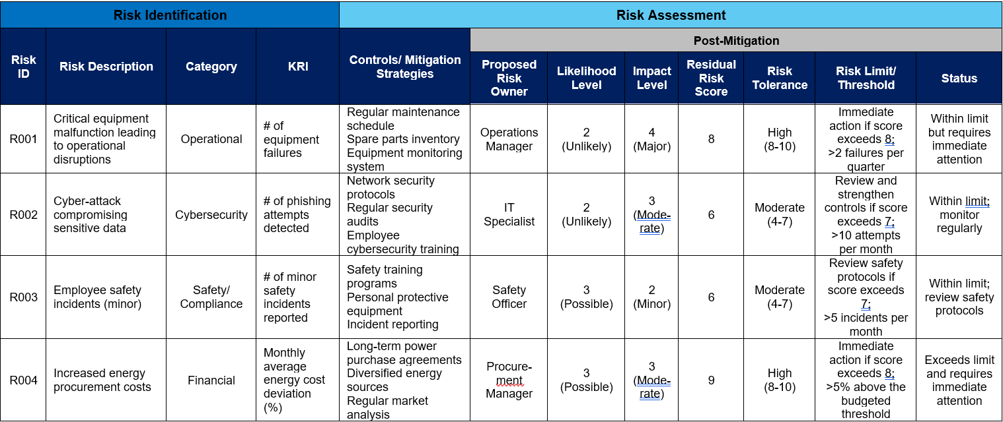
Risk Assessment Results – Risk Register
Notes:
Note: This is a sample only and should be tailored according to the utility’s needs.
Slide Objective: Provide overview of the entire read-ahead.
12

Slide 13
Risk Assessment Results – Heat Map
 | Likelihood
Impact |  | 1 (Very Unlikely) | 2 (Unlikely) | 3 (Possible) | 4 (Likely) | 5 (Almost Certain)
 | 5 (Catastrophic) | R002
 | 4 (Major) |  | R001
 | 3 (Moderate)
 | 2 (Minor) |  |  | R003
 | 1 (Negligible)
Notes:
Note: This is a sample only and should be tailored according to the utility’s needs.
Slide Objective: Provide overview of the entire read-ahead.
13

Slide 14
Understanding Cost-Benefit Analysis in Risk Mitigation
Purpose of cost-benefit analysis, or CBA, in risk mitigation is to evaluate the financial and strategic implications of mitigation options to prioritize the most effective actions
Identify Costs
Identify Benefits
Compare
Decision

Slide 15
Applying CBA to Identified Risks
Risk ID | Risk Description | Risk Category | Mitigation Options | Cost | Benefit | Net Benefit
R001 | Critical equipment malfunction leading to operational disruptions | Operational | Regular maintenance schedule | $500K/year | Avoid $2M/year in repair and downtime costs | +$1.5M/year
 |  |  | Replace aging equipment | $5M (one-time) | Avoid $10M in repair costs over 5 years | +$5M over 5 years
R004 | Increased energy procurement costs | Financial | Long-term power purchase agreements | $1M/year | Stabilize costs, saving $2M/year in volatility | +$1M/year
 |  |  | Invest in renewable generation | $10M (one-time) | Long-term savings of $20M over 10 years | +$10M over 10 years

Slide 16
Recommended Actions
[Insert high-level summary of recommended actions here to address most significant risks]

Slide 17
Mitigation Actions – Details
[Insert detail of the mitigation actions recommended addressing the most significant risks; include information on cost (if applicable), risk owners, timeline, next steps, etc.]

Slide 18
Appendix: Types of Risk Treatments
Avoidance is discontinuing activities that generate high risks.
Mitigation is implementing measures to reduce the risk’s likelihood or impact.
Transfer is sharing the risk through insurance, contracts, or partnerships.
Acceptance is choosing to retain the risk and prepare for its consequences.
Notes:
18

Slide 19
Appendix: Detail of Prioritized Risks
[Include information on the risk owners, specific departments monitoring the risks, etc.]
[It is helpful to include alignment of prioritized risks compared to similar-sized utility in the state/jurisdiction or in alignment with DOE state risk profile]
Notes:
19

