Slide 1
Attachment 3: Risk Identification Workshop PowerPoint Template
September 2024 | Version 1.0
#PublicPower www.PublicPower.org
1
Notes:
Note:
To change the format of the slide deck to fit the utility’s style, go to View, then go to Slide Master.
Change the format and customize according to the utility’s approved format and logo.

Slide 2
Table of Contents and Objectives
Topic | Page reference
Enterprise Risk Management Project Overview
Risk Identification Process | …
Risk Assessment - Our ask of you | …
References | …
1. Utility Strategic Goals | …
2. Risks Identified by Senior Leadership
3. Sample risk | …
4. Risk Identification Form | …
5. Sample Risk Rating Criteria | …
Objective
[Insert utility name] is enhancing its Enterprise Risk Management (ERM) program that promotes effective identification, analysis, reporting and monitoring of risks. [Insert utility name] is conducting an enterprise risk assessment session with [insert audience (i.e., senior management)] to identify top risks that can impact [insert utility name]’s strategic goals.
Value to [insert utility name]
Obtain visibility into the top risks that could impact [insert utility name] ’s strategic goals and enhance the senior leadership’s role in risk management.
Enable future evolution of good practice risk management program elements, such as risk reporting, audit response planning and reporting.
Stakeholder Actions
Be familiar with the material included in the pre-read ahead materials of the (virtual / in-person) risk identification workshop
Preliminarily fill in the risk identification form attached documenting the top-of-mind 3 to 5 risks that can impact [insert utility name]’s operations.
#PublicPower www.PublicPower.org
2
Notes:
Note: This is a sample only and should be tailored according to the utility’s needs.
Slide Objective: Provide overview of the entire read-ahead.
2

Slide 3
Risk vs Threat
 | Risk | Threat
Definition is… | Potential for loss or impact on objectives | External factor that could cause harm
Focuses on… | Uncertainty about outcomes | Specific sources of danger
Example | Power outage from equipment failure | Cyber attack on operational systems
Nature is… | Uncertainty | Specific harm
Origin is… | Can be internal or external | Typically external
It is managed by… | Anticipate and prepare | Identify and address
Risk management prepares for uncertainties, while threat management protects against specific dangers.
3
Notes:
Slide objective: Provide information on the difference of risk vs threat.

Slide 4
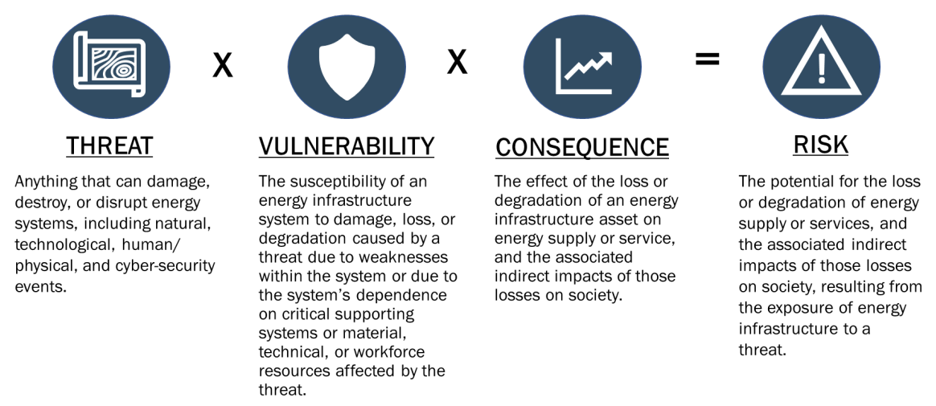
Understanding the Risk Equation
#PublicPower www.PublicPower.org
4
Notes:
Note: This is a sample and should be customized and tailored based on the utility’s needs and objectives.
Talking Points
1. The Risk Equation Definition:
Risk is quantified by multiplying the probability of an event occurring by the potential impact of that event.
This simple equation helps utilities prioritize which risks need the most attention based on their likelihood and potential consequences.
Application
Emphasize the importance of using this equation in your ERM process to systematically assess and manage risks.
2. Components of Risk
Threat
Define threats as external factors that can cause negative outcomes.
Use wildfires and cyber-attacks as examples to illustrate different types of threats that public power utilities might face.
Vulnerability
Explain vulnerability as the susceptibility of your utility’s assets or operations to those threats.
Highlight examples like transmission lines vulnerable to wildfires or gaps in cybersecurity that expose control systems to unauthorized access
Consequence
Discuss consequences as the potential outcomes if a threat exploits a vulnerability.
Examples include prolonged power outages due to damaged infrastructure or significant financial losses from repairs and customer dissatisfaction.
3. Key Takeaways
Assessing Risk
Stress the importance of evaluating each component—threat, vulnerability, and consequence—when assessing risk.
Prioritizing Risks
Explain how the Risk Equation aids in determining which risks require immediate attention based on their probability and impact.
Developing Mitigation Strategies
Conclude with the need to create strategies that reduce either the probability of threats or the impact of their consequences, ensuring your utility's resilience and operational efficiency.
4. Integration into ERM
ERM Process
Discuss how these elements feed into the broader ERM framework, enabling public power utilities to make informed decisions on risk management.
Encourage the audience to think about how these concepts apply to their own utility’s risk assessment process.
4

Slide 5
Enterprise Risk Management Project Overview
Objectives, value to [insert utility name], and milestones
Project overview and objectives
[Insert utility name] is enhancing its Enterprise Risk Management (ERM) program that promotes effective identification, analysis, reporting and monitoring of risks. [Insert utility name] is conducting an enterprise risk assessment session with [insert audience] (i.e., senior management) to identify top risks that can impact [insert utility name]’s strategic objectives.
Value to [insert utility name]
Enhancing visibility and fostering open leadership discussions into the top risks that could impact [Insert utility name]‘s ability to achieve its strategic objectives Enhanced cross-functional support, executive risk response alignment and risk ownership Stand up an ERM program to enable future evolution of a good practice risk management program Opportunity to improve future capital deployment and resource allocation
Engagement - key milestone timeline (may vary based on utility’s schedules). COLORS TO BE UPDATED (REFERENCE ONLY)
Phase I
Phase II
Phase III
Month 202X
Month 202X
Month 202X
Month 202X
Month 202X
Month 202X
Month 202X
Planning, preparation and kick-off
Leadership Risk Identification
Risk identification and assessment workshop(s)
Develop draft risk
register
Follow-Up risk assessment session and/or risk validation session w/ stakeholders
Final risk register
Reporting of risks and recommendations to governing board
Completed
In progress
Not started
#PublicPower www.PublicPower.org
5
Notes:
Note: This is a sample and should be customized and tailored based on the utility’s needs and objectives.
Slide Objective: Provide overview of the utility’s ERM project to inform stakeholders on what to expect.
5

Slide 6
ERM Program Mission and Vision or ERM Policy
[insert utility’s ERM program mission and vision statements or ERM policy here]
6
Notes:
Slide Objective: Provide overview of the utility ERM program’s mission and vision statement.

Slide 7
Risk Management Team/Committee
[insert ERM team structure here]
7
Notes:
Slide Objective: Provide information on the structure of the ERM team/risk management committee.

Slide 8




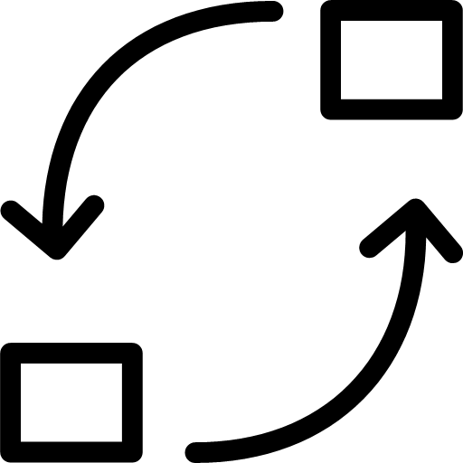
Risk Identification Process
Phase I start
Outputs: Project plan | Outputs: Draft risk register | Outputs: Expanded risk register include risk descriptions, known existing mitigations, and risk owners | Outputs: Risk identification workshop materials | Outputs: Detailed notes with data on likelihood and impact levels of each identified risk | Outputs: Validated risk register Identified risk ownership | Final risk register
Planning and Kickoff
Leadership Risk Identification
Risk Detailing
Workshop Preparation
Risk Assessment Workshop(s)
Risk Validation Session
Finalize Risk Register
Determine the timeline and identify all participants/ stakeholders involved.
Governing board suggests initial list of risks to focus on and composes a draft risk register with risk titles and descriptions.
Risk team takes the draft risk register and begin adding details ahead of the workshop by filling in tables with risk descriptions and known existing mitigation strategies based on research and data available.
Risk team prepares materials for the risk identification workshop.
Risk team orchestrates risk identification workshops to identify additional risks from stakeholders and start assessing risks.
Governing board and risk team validates the assessment results, prioritizes risks, and assigns risk owners.
Finalize risk register and ensure accuracy.
Phase I Completed
#PublicPower www.PublicPower.org
8
Notes:
Note: This is a sample only. Customize this based on the approach agreed upon with governing board and senior leadership. Some utilities may skip specific steps, and some utilities may add more steps into this process.
Slide Objective: Provide overview of the risk identification process timeline to the stakeholders and how they fit into this process and timeline.
8

Slide 9
Risk Identification
Our ask of you
1
Review the read-ahead materials prior to attending the risk identification workshop to brainstorm risk affecting [Insert utility name].
2
Use the risk identification form to capture identified risks prior to attending the workshop (list 1 risk per form). Provide details on at least 3-5 top-of-mind risks affecting the utility or to the department.
3
Be familiar with the references provided and come prepared to share inputs from the risk identification forms during the workshop.
#PublicPower www.PublicPower.org
9
Notes:
Note: This is a sample and should be customized and tailored based on the utility’s needs and objectives.
Slide Objective: Lays out what is being asked from the stakeholders which is (a) review the read ahead materials, (b) start identifying risks and document on the risk identification form, and (c) have awareness of the project and its timeline.
9

Slide 10
Risk Identification
References
Utilize the following slides to guide the risk identification process to prepare for the workshop
#PublicPower www.PublicPower.org
10
Notes:
Slide Objective: Provide introduction to the references that stakeholders will utilize to guide them with risk identification prior to attending the workshop.
10

Slide 11
Reference 1
Utility Strategic Goals
[insert utility strategic goals here]
#PublicPower www.PublicPower.org
11
Notes:
Slide Objective: Provide overview and reference to the utility’s strategic goals. This should inform stakeholders on the utility’s priorities and help them with aligning risks they identify to the strategic goals.
11

Slide 12
Reference 2
Risks Identified by Senior Leadership
[insert risks identified by senior leadership here]
#PublicPower www.PublicPower.org
12
Notes:
Slide Objective: Provide overview and reference to the priorities of the utility’s senior leadership (which are aligned to the utility’s strategic goals listed on the prior slide). This will inform stakeholders when completing the risk identification forms.
12

Slide 13
Reference 3
Sample risks
Financial
Compliance
1
Infrastructure upgrades: Challenges to upgrade and built resilient and reliable systems and networks for power generation and distribution may lead to power outages and reputational loss.
12
Capital cost
11
2
Changing climatic conditions: Challenges to focus on sustainable energy production due to global concerns around climate change (extreme conditions such as floods, heat waves etc.) may lead to operational disruptions, power outages, penalties and litigations.
Regulatory requirements
3
Unfavourable tariff rates and increasing industry competition: Challenges related to unfavourable tariff regulation or providing power to consumers at a competitive price can lead to lower profit margins.
Infrastructure upgrades
1
4
6
Usage of DER
Supply chain
7
Growing cyber
risks
4
Supply chain resilience: Risk related to resilient supply chain for uninterrupted production of power due to uncertain geopolitical and economic global scenarios (such as war, pandemic).
Changing climatic condition
2
5
10
Industrial accidents
Construction delays
Industrial accidents: Occupational hazard such as fire, infrastructure damage due to non-maintenance can result in workplace fatalities and operational disruptions.
3
8
Growing talent gap
5
Strategic
Tariff rates and industry competition
Changing customer expectations
Operational
9
6
Increasing usage of DERs (Distributed Energy Resources): Rising usage of DERs such as rooftop solar equipment, EV chargers etc. by households and corporates can lead to challenges in building architecture to integrate them with the grids.
10
Construction delays: Risk of extended set up time for commissioning of power generation projects due to huge project financing cost, delays in land acquisition, approvals from civic bodies etc.
7
Cybersecurity threat related to IT/OT: Industrial accidents / shut-downs arising from the stoppage / malfunctioning of the critical production assets due to cyber-attacks on the IT/OT.
11
Changing regulatory requirements and policy landscape: Concerns related to adherence of stringent compliance norms related to environment (coal plant operations and closures), labour, tax etc. in generation, transmission and distribution of power.
8
Growing talent gap: Challenges to hire skilled individuals to manage critical/ technical operations in the sector and retain the workforce amid rising concerns around prospects of non-renewable focused power sector may lead to sub optimal services and reputational damage.
12
Access to capital and rising cost of capital: Challenges to raise capital for expansion and management of existing power plants at feasible provisions to ensure financial viability of the project.
9
Changing customer expectations: Challenges to deal with customer expectations related to cost reductions, ease of payments, sustainable production etc. may lead to customer dissatisfaction resulting in loss of revenues.
#PublicPower www.PublicPower.org
13
Notes:
Slide Objective: Provide overview of risks that stakeholders can use to guide them when identifying risks affecting the utility or their specific departments.
13

Slide 14
Reference 3
Other risks to consider
Risk Categories | Risk Title
Financial | Customer expectations and affordability Increasing costs of insurance Aging power infrastructure
Operational | Cybersecurity threats Physical damage to infrastructure Systems implementation challenges Third-party vendor vulnerabilities Supply chain disruptions affecting equipment Extreme weather events and natural disasters Interdependency with other power generation sources Lack of job-specific personnel training Insider threats
Safety | Physical threats to the grid (vandalism, natural disasters) Workplace safety for utility employees Lack of equipment maintenance Inadequate public safety power shutoffs Lack of incident management planning Lack of emergency response planning Ineffective facility housekeeping
Strategic | Talent gap due to retiring workers Shift toward clean energy and renewable sources Growth in load demand for power generation due to increasing population, artificial intelligence utilization, etc. Interdependency with other critical infrastructure Increased misinformation online and social media
#PublicPower www.PublicPower.org
14
Notes:
Slide Objective: Provide overview of risks that stakeholders can use to guide them when identifying risks affecting the utility or their specific departments.
14

Slide 15
Reference 4
Sample risk identification table for a hurricane (as a risk)
This is a sample risk documented on the risk identification form for users to use as a guide when completing their forms.
#PublicPower www.PublicPower.org
15
Notes:
Note: See Appendix F of the Risk Toolkit for the Microsoft Word version prepared for printing layout.
Slide Objective: Provide sample of the risk identification form to guide stakeholders on how they should fill out the form.
15

Slide 16
Reference 5
Sample risk rating criteria for likelihood and impact
Level | Likelihood Criteria | Description
1 | Rare: Unlikely to occur, <X% chance | Risks that are highly unlikely and infrequent. For example, a rare catastrophic failure of a power generation unit that occurs less than once every X years.
2 | Unlikely: Could occur occasionally, X% - X% chance | Risks that are possible but not expected to occur often. For instance, a minor but unusual equipment malfunction that happens once every X years.
3 | Possible: Might occur, X% - X% chance | Risks with a reasonable probability of occurring. An example is a seasonal storm (Hurricane Sandy) with a X% chance of causing temporary power lines outages each year.
4 | Likely: Will probably occur, X% - X% chance | Risks that are expected to occur at some point. For instance, routine transformer failures from regular wear and tear, expected to happen once every X years.
5 | Almost Certain: Expected to occur, > X% chance | Risks that are highly likely to occur almost regularly. For example, annual minor faults in distribution lines due to frequent vegetation growth occurring every X year.
Level | Impact Criteria | Description
1 | Insignificant: No significant impact | Risks that have negligible effects. For example, a minor error in a customer billing that does not affect financial statements or customer service.
2 | Minor: Limited impact, easily manageable | Risks with small but noticeable effects. For instance, a brief power outage affecting a single business for less than X minutes, with minimal disruption.
3 | Moderate: Noticeable impact, manageable | Risks with significant impacts. For example, a localized outage affecting X homes for several hours, causing inconvenience and requiring crew response.
4 | Major: Significant impact, requires attention | Risks causing considerable disruption. For example, a major transformer failure leading to a city-wide blackout lasting X hours, affecting thousands of residents and businesses.
5 | Catastrophic: Severe impact, critical | Risks with extreme consequences. For example, a major grid failure resulting in a widespread blackout affecting multiple jurisdictions, causing extensive financial loss and safety hazards.
#PublicPower www.PublicPower.org
16
Notes:
Note: This is an example and should be updated based on the utility’s defined criteria for the risk assessment and scoring process.
16

