Slide 1
Attachment 1: ERM Proposal PowerPoint Template
September 2024 | Version 1.0
#PublicPower www.PublicPower.org
1
Notes:
Note: This is a sample and should be customized and tailored based on the utility’s needs and objectives.

Slide 2
Table of Contents
Topic | Page reference
Break the ice – Risk 101 | X
Enterprise risk management (ERM) overview What is ERM? | X
Why should [insert utility name] care? Strategic advantage through effective ERM | X
Proposed governance for [insert utility name]’s risk management structure | X
Typical ERM lifecycle Phased approach for [utility name] | X
Next steps Proposed ERM Program development plan | X
#PublicPower www.PublicPower.org
2
Notes:
Note: This is a sample and should be customized and tailored based on the utility’s needs and objectives.
2

Slide 3
Break the ice
Think about what risk means to the public power industry
Potential Rewards
High returns through optimized operations and investments in infrastructure.
Potential Risks
Market Volatility – Similar to the stock market, energy markets can be unpredictable.
Loss of Capital – Poor investments or operational failures can lead to significant financial losses.
Invest in the stock market
Potential reward: high returns
Potential risk: loss of invested capital
Potential risk: market volatility
#PublicPower www.PublicPower.org
3
Notes:
Note: This is a sample and should be customized and tailored based on the utility’s needs and objectives.
Discussion Prompt:
Think about what risk means to the public power industry
Consider the rewards (e.g., providing reliable service, meeting regulatory standards, financial stability).
Consider the risks (e.g., operational failures, regulatory compliance, market fluctuations).
Discussion Questions:
How do these concepts of reward and risk apply to decisions your utility makes daily?
What specific risks are most concerning for public power utilities today?
How can a robust Enterprise Risk Management (ERM) program help balance these risks and rewards?
3

Slide 4
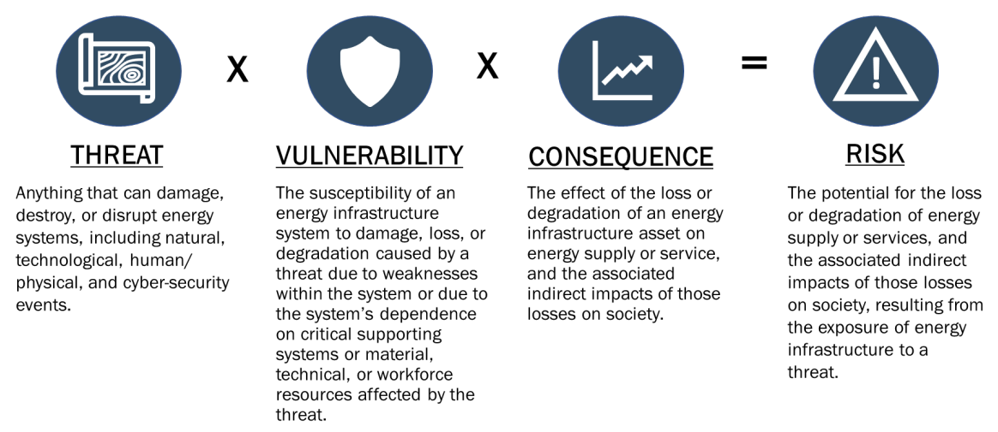
Understanding the Risk Equation
#PublicPower www.PublicPower.org
4
Notes:
Note: This is a sample and should be customized and tailored based on the utility’s needs and objectives.
Talking Points
1. The Risk Equation Definition:
Risk is quantified by multiplying the probability of an event occurring by the potential impact of that event.
This simple equation helps utilities prioritize which risks need the most attention based on their likelihood and potential consequences.
Application
Emphasize the importance of using this equation in your ERM process to systematically assess and manage risks.
2. Components of Risk
Threat
Define threats as external factors that can cause negative outcomes.
Use wildfires and cyber-attacks as examples to illustrate different types of threats that public power utilities might face.
Vulnerability
Explain vulnerability as the susceptibility of your utility’s assets or operations to those threats.
Highlight examples like transmission lines vulnerable to wildfires or gaps in cybersecurity that expose control systems to unauthorized access
Consequence
Discuss consequences as the potential outcomes if a threat exploits a vulnerability.
Examples include prolonged power outages due to damaged infrastructure or significant financial losses from repairs and customer dissatisfaction.
3. Key Takeaways
Assessing Risk
Stress the importance of evaluating each component—threat, vulnerability, and consequence—when assessing risk.
Prioritizing Risks
Explain how the Risk Equation aids in determining which risks require immediate attention based on their probability and impact.
Developing Mitigation Strategies
Conclude with the need to create strategies that reduce either the probability of threats or the impact of their consequences, ensuring your utility's resilience and operational efficiency.
4. Integration into ERM
ERM Process
Discuss how these elements feed into the broader ERM framework, enabling public power utilities to make informed decisions on risk management.
Encourage the audience to think about how these concepts apply to their own utility’s risk assessment process.
4

Slide 5
Break the ice
Risk vs Threat
While individuals face risks in their personal decisions, utilities encounter risks on a much larger scale, affecting their stakeholders and the market at large.
Risk to public power utilities can involve scenarios that lead to financial loss, reputational damage, or operational disruption.
Types of risks that utilities commonly encounter:
 | Risk | Threat
Definition is… | Potential for loss or impact on objectives | External factor that could cause harm
Focuses on… | Uncertainty about outcomes | Specific sources of danger
Example… | Power outage from equipment failure | Cyber attack on operational systems
Nature is… | Uncertainty | Specific harm
Origin is… | Can be internal or external | Typically external
It is managed by… | Anticipate and prepare | Identify and address
Strategic Risk
Compliance Risk
Operational Risk
Financial Risk
Reputational Risk
Cybersecurity Risk
Environmental Risk
Geopolitical Risk
Supply Chain Risk
Human Resource Risk
#PublicPower www.PublicPower.org
5
Notes:
Note: This is a sample and should be customized and tailored based on the utility’s needs and objectives.
5

Slide 6
Enterprise Risk Management
What is ERM?
Enterprise Risk Management (ERM) is a structured approach used by an organization's leadership to plan strategies and operations with potential risks in mind. Senior management identifies and manages these risks within their risk tolerance, helping ensure the organization meets its goals.
ERM helps organizations use smart insights and a results-focused approach to improve risk management. It integrates with daily business activities and important decisions, enhancing performance and creating more value.
Positive
Risks that offer opportunities for growth and competitive advantage
Outside
External factors offering positive / negative effects, beyond organization’s direct control
Negative
Material risks that offer only negative impacts
Risk
Definition
Value
^{ERM}
Strategic alignment
Revenue growth
Stakeholder perception and reputation
Operational excellence
Operating margin
Asset efficiency
Employee satisfaction
#PublicPower www.PublicPower.org
6
Notes:
SUGGESTION
RISK:
POSITIVE - Upside Risks: These are potential positive outcomes that can arise from taking certain risks. For instance, investing in renewable energy sources might present an upside risk where the utility could benefit from government incentives, lower operational costs, and increased customer demand for green energy, leading to a competitive advantage and higher market share.
OUTSIDE - Outside Risks: These are risks that come from external factors beyond the utility's control, which can have either positive or negative outcomes. An example is climate-related risks, such as the increased frequency of wildfires due to changing weather patterns. Wildfires can threaten transmission lines and disrupt service, posing a significant challenge to maintaining reliable power delivery.
NEGATIVE - Downside Risks: These are risks that could lead to negative consequences for the utility. Supply chain disruptions are a downside risk that can affect the availability of critical equipment needed for power transformation. This can result in delays in maintenance or expansion projects, increased costs, and potential service interruptions, all of which can negatively impact the utility's operations and financial performance.
VALUE:
For a utility like ours, it's crucial to make sure that every part of the business is working towards the same goals. Here's how ERM can be relevant to the following key areas:
Strategic Alignment: ERM supports in having all the risks managed in a way that supports the utility's long-term plans and goals.
Revenue Growth: By identifying and managing risks, ERM can helps us protect the utility's income sources and finds safe ways to increase earnings.
Stakeholder Perception and Reputation: ERM can help us maintaining a good image by reducing the chances of incidents that could harm our reputation among customers, investors, and the community.
Operational Excellence: ERM focuses on improving the utility's operations by preventing disruptions and ensuring that everything runs smoothly and efficiently.
Operating Margin: By controlling risks, ERM helps to keep costs in check, which can lead to better profit margins for the utility.
Asset Efficiency: ERM helps ensure that the utility's equipment and infrastructure are used effectively, reducing waste and downtime.
Employee Satisfaction: ERM contributes to a safer and more stable work environment, which can lead to happier and more engaged employees.
By integrating ERM into these areas, we can better manage the uncertainties in our operations and strategic efforts, leading to improved performance and sustainability.
6

Slide 7




Why should [insert utility name] care?
Strategic advantage through effective ERM
As the public power utility sector navigates the complexities of regulatory changes, environmental concerns, and evolving consumer expectations, the importance of an enhanced risk management framework cannot be overstated.
Operational / Financial preparedness
[Insert utility name]
Community confidence
Please populate this box with relevant information specific to your utility (see SUGGESTION in the note section)
Strengthens community trust by ensuring consistent service, which leads to higher customer satisfaction.
Prepares utilities for swift recovery leading to fewer service interruptions and more stable pricing for customers.
E
ERM
Regulatory vigilance
M
Strategic risk intelligence
Informs leaders about potential risks enabling proactive measures to protect service quality and customer satisfaction.
Keeps utilities ahead of the curve with regulations, avoiding fines, and enabling smoother operations through compliance.
From reactive to proactive risk management
#PublicPower www.PublicPower.org
7
Notes:
SUGGESTION
To effectively convey the significance of Enterprise Risk Management (ERM) within your public power utility presentation, please populate the designated slide box with relevant information from your organization.
For example, think about the following critical information:
Incident Statistics: Include recent data on the frequency, nature, and outcomes of service disruptions, security breaches, and safety incidents. This should illustrate the real-world implications of risks and the importance of a robust ERM framework.
Historical Impact Analysis: Identify and describe the most impactful risks the utility has faced over the past five years. Highlight specific events that had significant operational, financial, or reputational consequences.
Risk Mitigation Outcomes: Provide examples of successful risk mitigation strategies that were implemented in response to these incidents. Detail how Risk Mangement played a role in managing these risks and the benefits gained from these actions (and how a more robust ERM Program could further enhance resilience)
Lessons Learned: Summarize key lessons learned from past experiences and how they have shaped current ERM practices. Emphasize the continuous improvement of risk management processes as a result of these insights.
7

Slide 8
Proposed Governance for [insert utility name]’s Risk Management Structure
For [utility name], the recommendation is to form a risk management committee composed of representatives from the utility’s senior leadership and business units.
[This is a collaborative decision that the governing board and senior leadership should agree on as the outcome of this meeting. The structure will look different for each utility as every utility has different leadership structure. Tailor this according to the utility’s leadership structure.]
Board, City Council, Municipal Council, etc.
Chief Administrative Officer/ Chief HR Officer
Human Resources Department
Operations Department
Governing Board
Senior Leadership
Business Units
Chief Operating Officer
Chief Technology Officer
Information Technology Department
Customer Service Department
Security and Safety Department
Transmission or Distribution Department
Chief Financial Officer
Accounting and Payroll Department
Purchasing Department
CEO or General Manager
#PublicPower www.PublicPower.org
8
Notes:
Note: This is a sample and should be customized and tailored based on the utility’s needs and objectives.
8

Slide 9
Typical ERM Lifecycle
Phased approach for [utility name]
Phased approach to enhance ERM capabilities
Below is a sample representation of a typical ERM lifecycle. The six steps are also color-coded to tie with the three “phases” [utility name] will pursue in enhancing its ERM capabilities.
Phase I
Leadership buy-in, ERM team set-up, risk identification
Identify and agree on risks to the achievement of strategic goals and objectives of the utility
Phase II
Program stand up (obtain leadership buy in and ERM team set up, etc.)
Identify
Enterprise
Risk Management Process
Risk rating criteria & scoring, assessment workshop, scoring risks, risk prioritization, evaluating mitigation strategies, identifying residual risk score
Report on risk status by establishing cadence and framework for reporting to senior leadership
Report
Agree on rating criteria and risk tolerance levels and limits. Assess risks against criteria
Assess
Phase III
Monitor
Response
KRI design and framework set-up, monitoring of top risks, communication & reporting to leaders
Identify and document risk responses to mitigate risks to within acceptable risk tolerance and limits.
Identify residual risk exposure based on mitigations and develop treatment plans.
Monitor and measure progress of risk responses on a regular basis to identify change from the performance level required or expected
#PublicPower www.PublicPower.org
9
Notes:
Note: This is a sample and should be customized and tailored based on the utility’s needs and objectives.
9

Slide 10
Next Steps
Proposed ERM program development plan
Q1 202X
Set Up Governance Structure
Q2 202X
Project Planning
Q3 – Q4 202X
ERM Phase I and II Execution
Q1 202X
ERM Phase III Execution
Identify and appoint a risk management project lead.
Identify and define the risk management team members, roles, and responsibilities.
Formalize roles and responsibilities in a risk management project charter.
Create a project plan with key milestones and timelines, including budget and resource requirements.
Obtain approval of project plan from senior leadership.
Develop a communications plan and inform stakeholders of newly established risk management efforts.
Develop and obtain approval on templates and risk criteria.
Conduct ERM 101 training sessions for stakeholders.
Execute Phase I and II activities.
Develop draft and final risk register.
Establish a schedule for regular progress reporting on risk mitigations.
Set up monitoring mechanisms for tracking the effectiveness of risk responses.
Implement a feedback loop to refine the ERM process based on monitoring outcomes.
#PublicPower www.PublicPower.org
10
10
Notes:
This is a sample timeline only and must be tailored.
Provide “immediate next steps” to stand up an early-stage program.
10

